Slide 1
5-Level HANPC Rectifier
Semiconductor Losses Calculation
Weekly Update
SEEEDS in ZJU
Email: zyf1125@zju.edu.cn
Power Electronics Research Institute
College of Electrical Engineering
Zhejiang University

Slide 2
1
Passive component calculation
2
5L Semiconductor Losses
3
3L Semiconductor Losses
4
CHB Semiconductor Losses

Slide 3
1 Passive component calculation
Minimum inductance usage at different switching frequencies(half of equivalent output frequency), meeting 5% current THD
For this system, when the switching frequency is less than 1.5 kHz, the increase of the switching frequency can reduce the inductance more significantly.

Slide 4
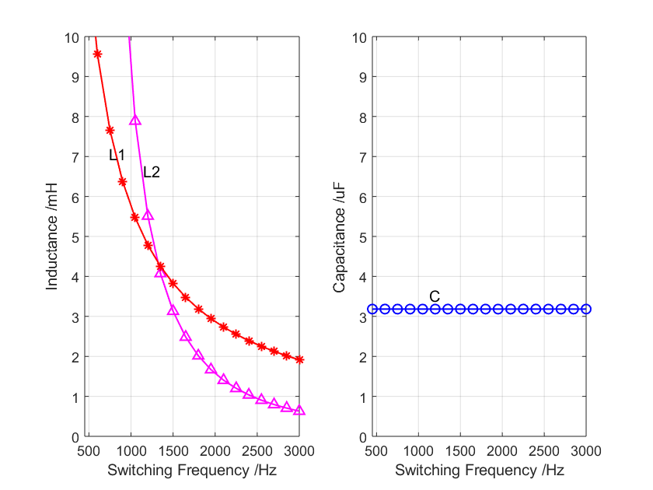
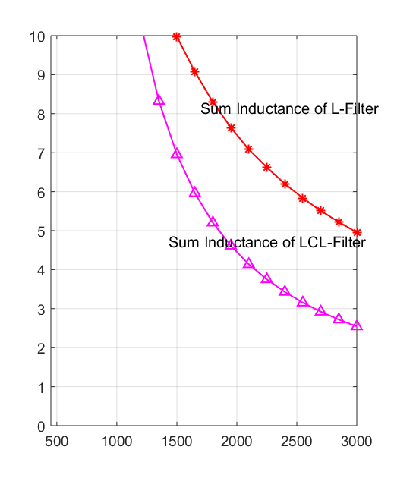
1 Passive component calculation
LCL-Filter Design
The sum of Inductance is decreased

Slide 5
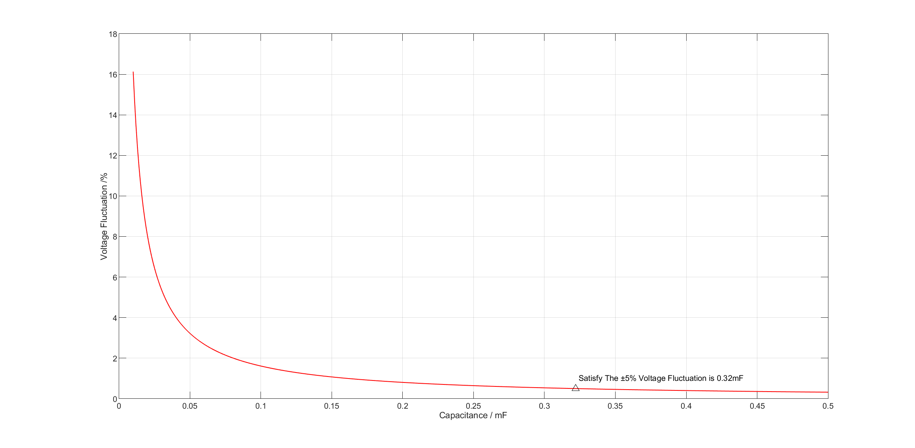
1 Passive component calculation
DC Capacitor Design
In order to satisfy the ±5% fluctuation of DC voltage in NPC topology, the capacitor need to be 0.32mF

Slide 6
1 Passive component calculation
Floating Capacitor Design
When Satisfying the maximum fluctuation on the floating capacitor, the relationship between the switching frequency and the capacitance is shown above.

Slide 7
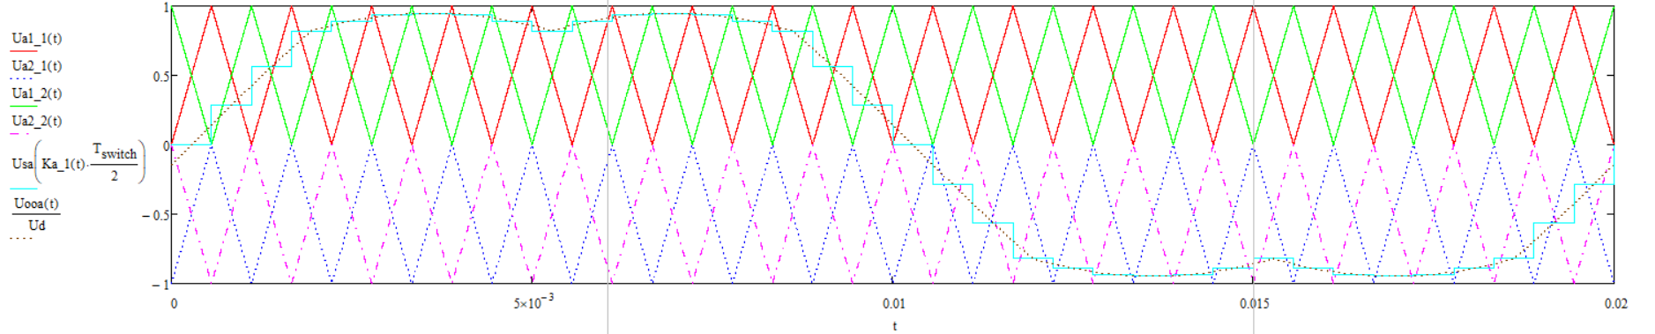
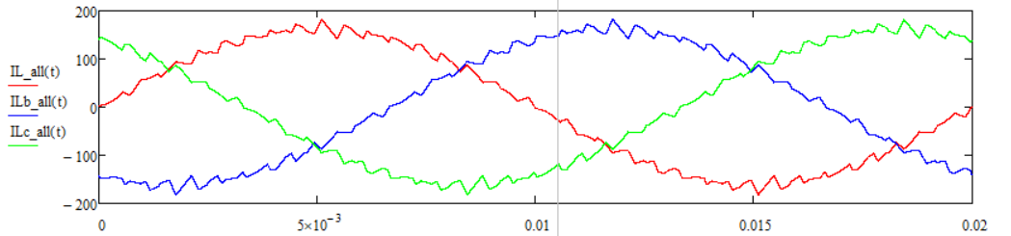
2 Semiconductor Losses
Calculation Method
Calculate the parameter of the system, considering the different inductance under different frequency.
Calculate the current ripple in 3-phase system.
Calculate each switch’s conduction losses of IGBT and diode and switching losses.
电压等级 /V | 型号 | 厂商 | 每个开关芯片串联数量 | 每个 IGBT承压 /V | 25℃总串联压降(200A) / V | 25℃单个开关总开关损耗 / mJ | 器件数量 | 载波频率 /Hz | 等效输出频率 /Hz
3300V IGBT | FF200R33KF2C | Infineon | 2 | 1875 | 7.4 | 355.5 | 4×6(switches) ×3(phase) | 450 | 900
1700V IGBT | FF225R17ME4_B11 | Infineon | 4 | 1071.4 | 6.8 | 937.5 | 7×6(switches) ×3(phase) | 900 | 1800
1700V SiC | CAS300M17BM2 | Cree | 4 | 1071.4 | 5.69 | 85.19 | 7×6(switches) ×3(phase) | 3600 | 3600
1200V SiC | CAS300M12BM2 | Cree | 5 | 750 | 2.8 | 49.58 | 10×6(switches) ×3(phase) | 7200 | 7200

Slide 8
2 Semiconductor Losses
Losses under different load
At this Frequency, the most efficiency point is around 1.2MW

Slide 9
2 Semiconductor Losses
Losses under different frequency

Slide 10
2 Semiconductor Losses
Losses under different frequency

Slide 11
2 Semiconductor Losses
Losses under different frequency
 | FF225R17ME4_B11 | FF200R33KF2C
Inductance/mH | 0.008297 | 0.016934
Switching frequency/Hz | 1800 | 900
IGBT Conduction Loss(W) | 4323.289 | 3925.095
IGBT switching loss(W) | 2130.511 | 3073.319
Rec total loss(W) | 6453.8 | 6998.414
Rec Semi Efficiency(%) | 0.990319 | 0.989502
 | CAS300M17BM2 | CAS300M12BM2
Inductance/mH | 0.008297 | 0.016934
Switching frequency/Hz | 3600 | 3600
IGBT Conduction Loss(W) | 2799.02133 | 2234.4865
IGBT switching loss(W) | 464.246276 | 417.653417
Rec total loss(W) | 3263.26761 | 2652.13992
Rec Semi Efficiency(%) | 0.9951051 | 0.99602179
Under the same switching frequency, the 1200V SiC is more efficiency than 1700V SiC ,because of the lower conduction losses and switching losses.
SiC MOS is better than Si IGBT，

Slide 12
2 Semiconductor Losses
Losses under different frequency
The higher frequency the lower efficiency and the lower inductance, mainly because of the switching losses.
The conduction losses of 3300V IGBT is lower than that of 1700V IGBT, but the switching losses is much higher.so that, the 1700V IGBT is prefer.

Slide 13
2 Semiconductor Losses
1700V IGBT Losses
The higher frequency the lower efficiency, mainly because of the switching losses.
At high frequency, the lighter load the lower efficiency.

Slide 14
2 Semiconductor Losses
3300V IGBT Losses
The higher frequency the lower efficiency, mainly because of the switching losses.
At high frequency, the lighter load the lower efficiency.

Slide 15
2 Semiconductor Losses
1200V SiC Losses
The higher frequency the lower efficiency, mainly because of the switching losses.
At low frequency, the lighter load the lower efficiency.

Slide 16
2 Semiconductor Losses
1700V IGBT Losses
The higher frequency the lower efficiency, mainly because of the switching losses.
At low frequency, the lighter load the lower efficiency.

Slide 17
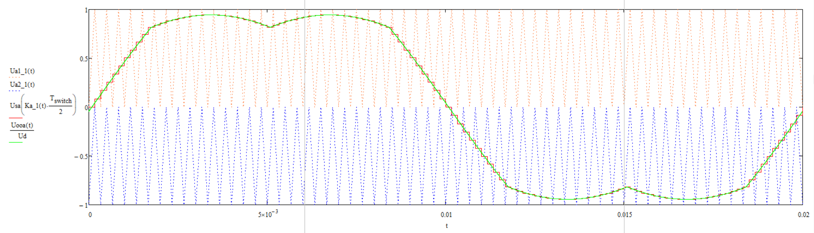
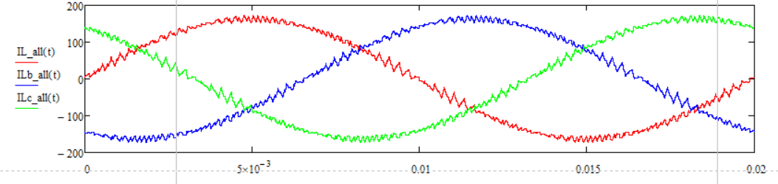
3 3-L Semiconductor Losses
电压等级 /V | 型号 | 厂商 | 每个开关芯片串联数量 | 每个 IGBT承压 /V | 25℃总串联压降(200A) / V | 25℃单个开关总开关损耗 / mJ | 器件数量 | 载波频率 /Hz | 等效输出频率 /Hz
3300V IGBT | FF200R33KF2C | Infineon | 4 | 1875 | 12.95 | 711.11 | 4×6(switches) ×3(phase) | 450 | 450
1700V IGBT | FF225R17ME4_B11 | Infineon | 7 | 1071.4 | 13.6 | 1875 | 7×6(switches) ×3(phase) | 900 | 900
1700V SiC | CAS300M17BM2 | Cree | 7 | 1071.4 | 9.96 | 170.37 | 7×6(switches) ×3(phase) | 3600 | 3600
1200V SiC | CAS300M12BM2 | Cree | 10 | 750 | 5.6 | 99.17 | 10×6(switches) ×3(phase) | 7200 | 7200

Slide 18
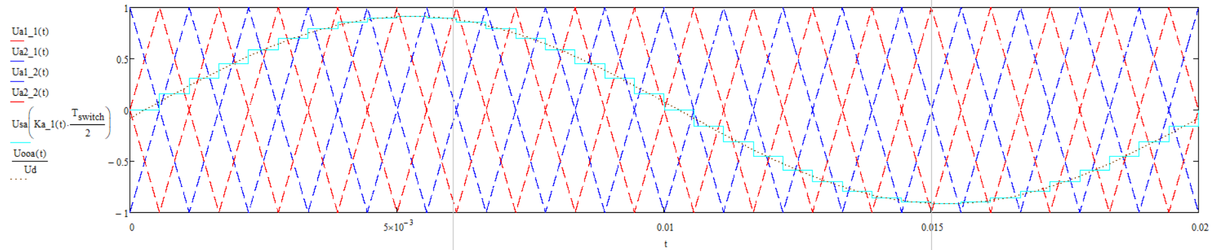
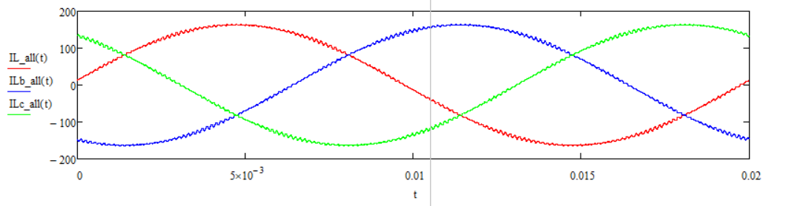
4 CHB Semiconductor Losses
System Parameter

Slide 19
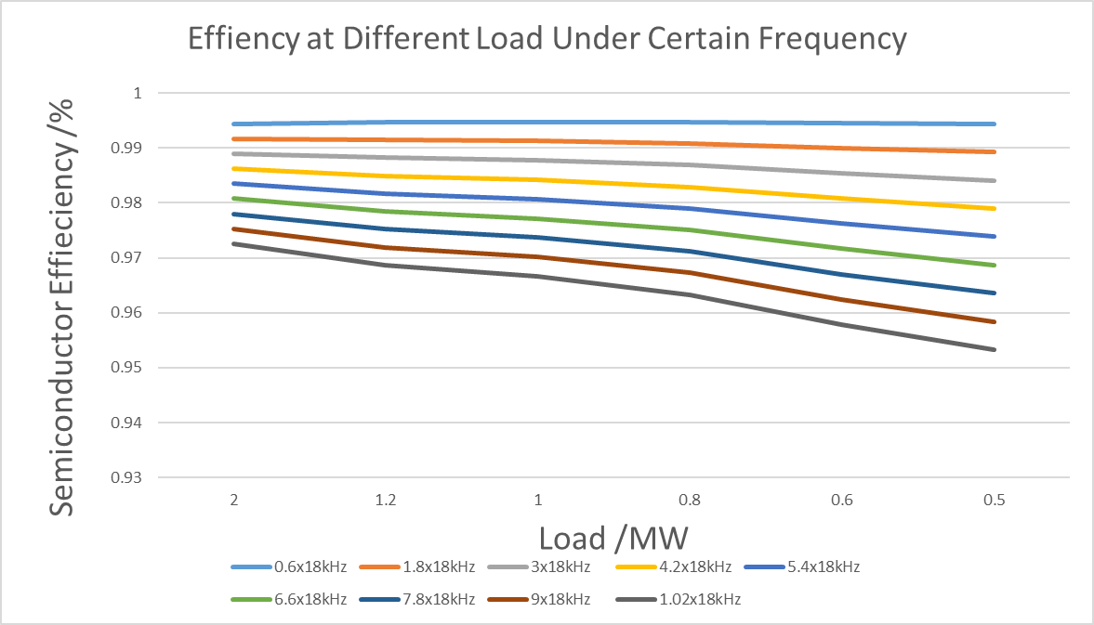
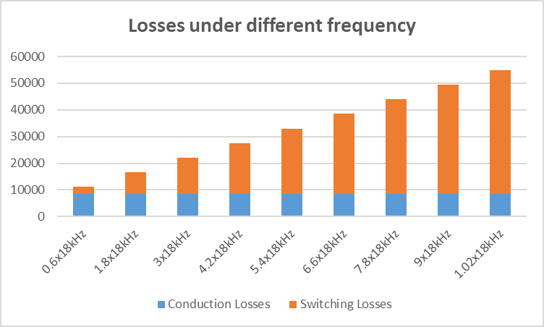
4 CHB Semiconductor Losses
CHB 1700V IGBT
At high frequency, the lighter load the lower efficiency.
At same equivalent output frequency, CHB has a little more conduction losses than 5L-ANPC but much lower switching Losses.
At same switching frequency, compared to 5L-ANPC, although the total losses is large, but higher voltage level and higher output frequency.

Slide 20
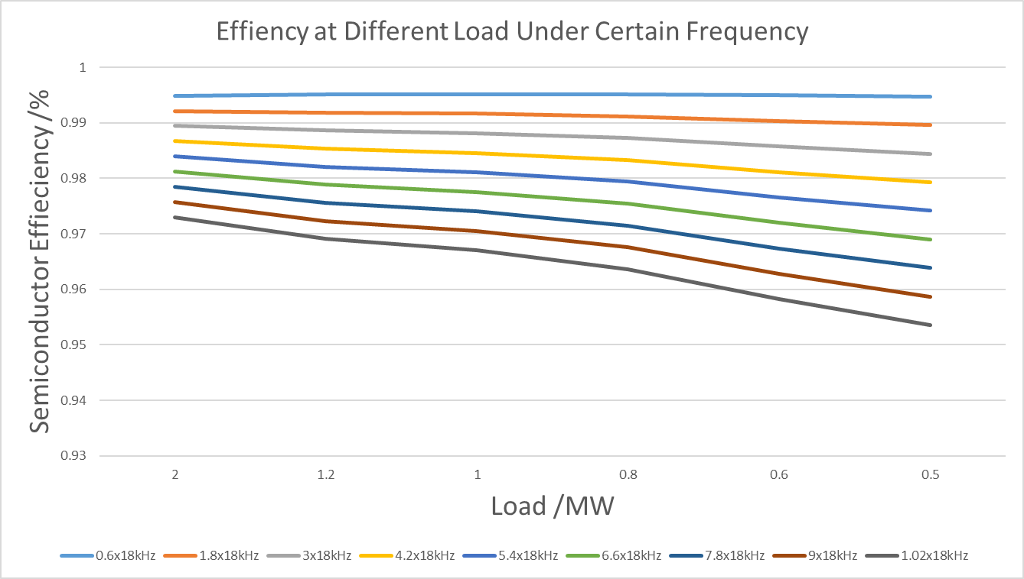
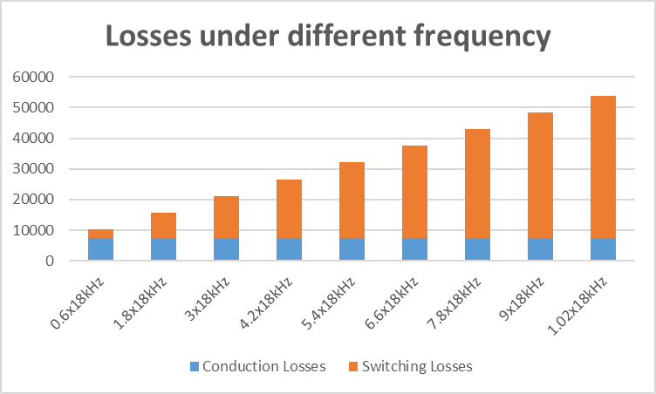
4 CHB Semiconductor Losses
3L+CHB 1700V IGBT
At high frequency, the lighter load the lower efficiency.
Compared to 1700V IGBT CHB, the conduction Losses and switching losses are not much different between the two topology. What’s more it Appear more voltage levels.

Slide 21
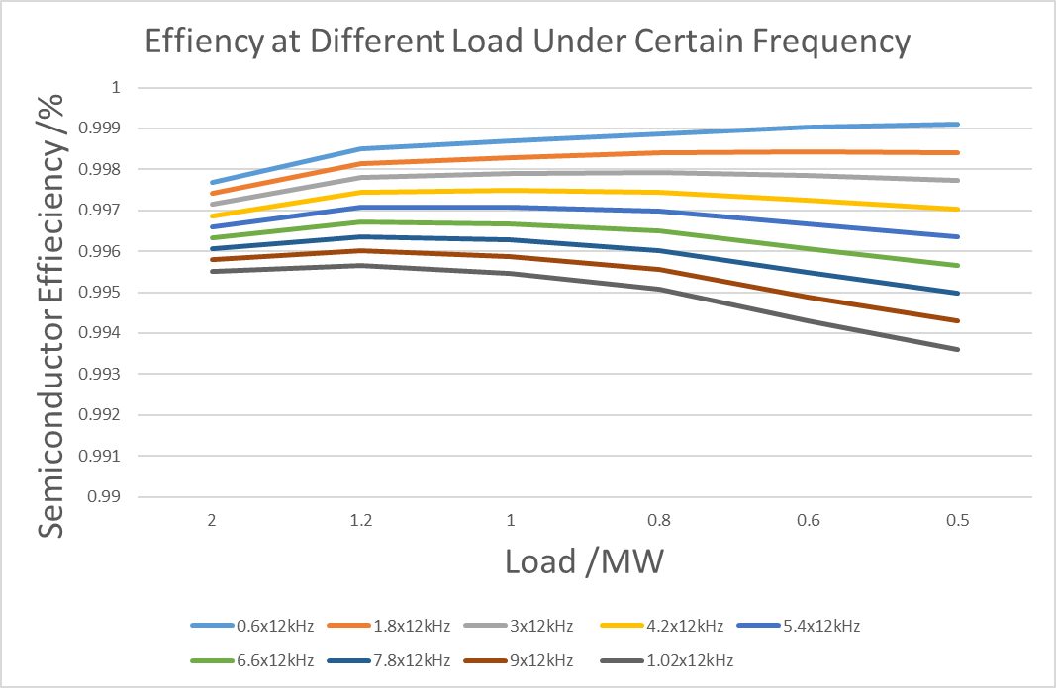
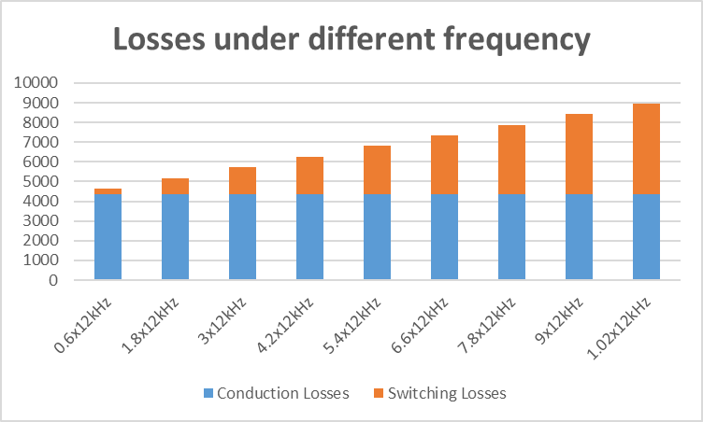
4 CHB Semiconductor Losses
CHB 1200V SiC MOSFET
At high frequency, the lighter load the lower efficiency, at low frequency, the situation is reversed.
At same equivalent output frequency, CHB has a little more conduction losses than 5L-ANPC but much lower switching Losses.At same switching frequency, compared to 5L-ANPC, although the total losses is large, but higher voltage level and higher output frequency.
Compared to all kinds of IGBT, SiC is also prefered in CHB.

Slide 22
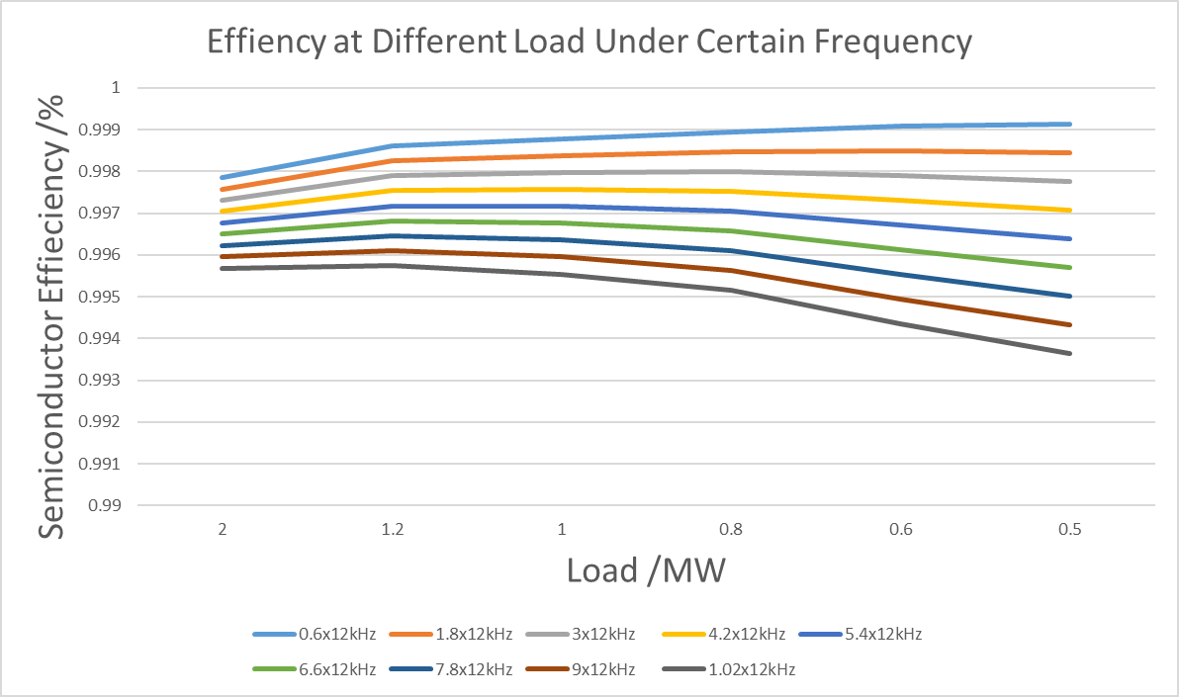
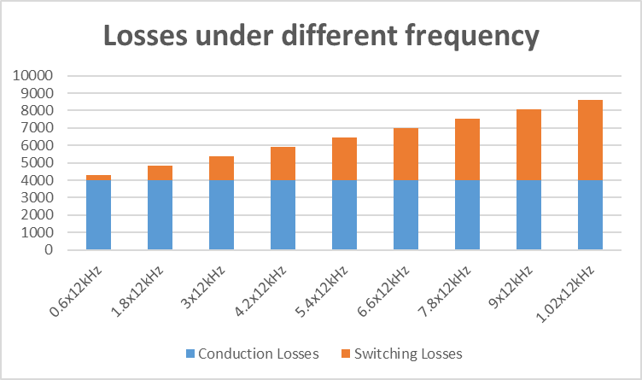
4 CHB Semiconductor Losses
3L+CHB 1200V SiC MOSFET
At high frequency, the lighter load the lower efficiency.
Compared to 1200V SiC CHB, the conduction Losses and switching losses are not much different between the two topology. What’s more it Appear more voltage levels.

Slide 23
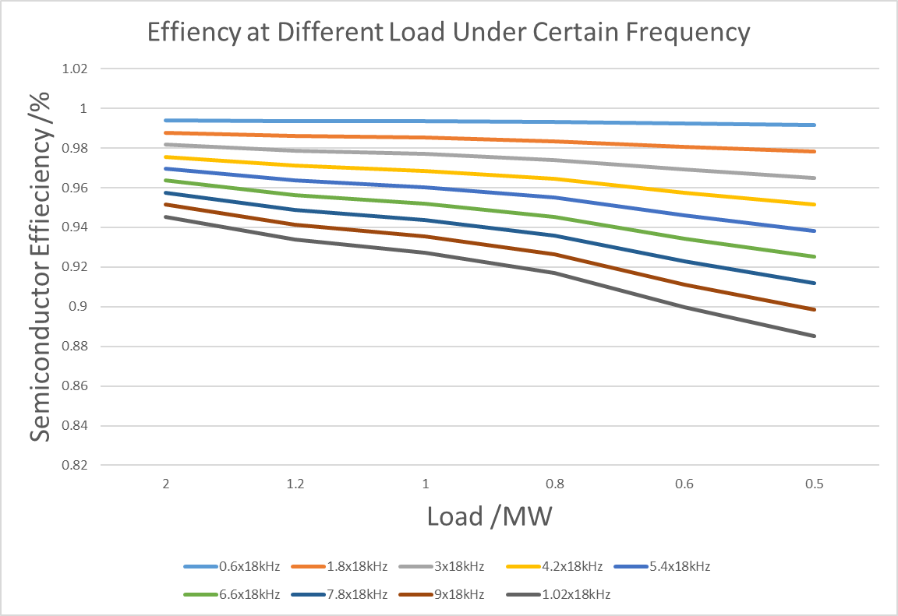
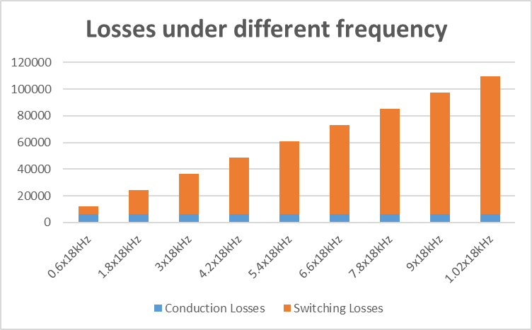
4 CHB Semiconductor Losses
CHB 3300V IGBT
At high frequency, the lighter load the lower efficiency.
At same equivalent output frequency, CHB has a little more conduction losses than 5L-ANPC but much lower switching Losses.
At same switching frequency, compared to 5L-ANPC, although the total losses is large, but higher voltage level and higher output frequency.
Compared to 1700V IGBT, 3300V IGBT has lower conduction losses, but much higher switching losses and total losses which is similar with the situation of ANPC

Slide 24
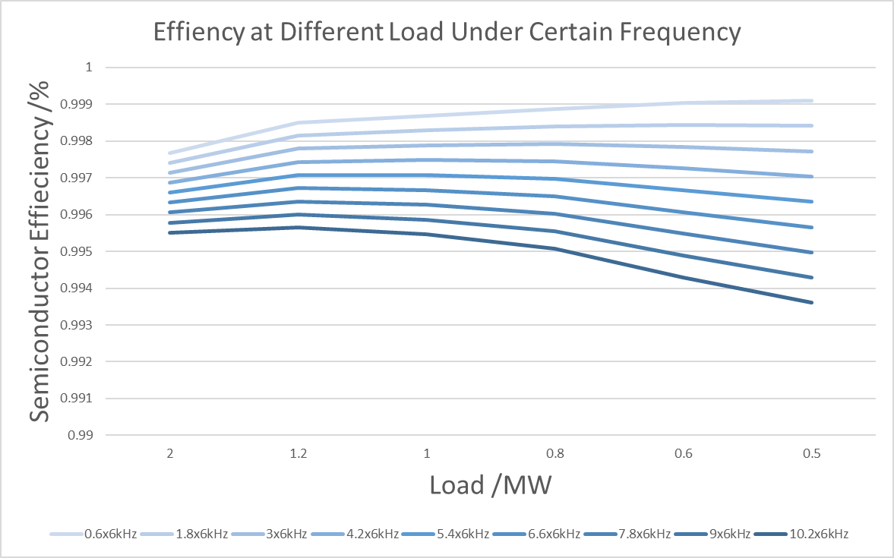
5 Final Project
CHB 3-L 1200SiC
LOAD/MW | 2 | 1.2 | 1 | 0.8 | 0.6 | 0.5
EFFICIENCY/% | 0.995516 | 0.995647 | 0.995462 | 0.995077 | 0.994294 | 0.993603

Slide 25
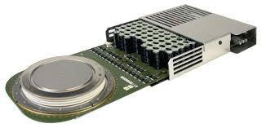




Thanks
Sustainable & Efficient Electric Energy Delivery Systems Laboratory

